Slide 1
Unit -3
Design Thinking & Liberal Art

Slide 2
Contents
Concept of Design Thinking
Difference Between Designer and Scientist
Stages of Design Thinking
Difference Between Convergent and Divergent Thinking
Definition of Liberal Art
Importance of Liberal Art
Role of Art and Culture to Innovate Business.
s

Slide 3
Concept of Design Thinking
Design Thinking is a methodology used by designers to solve complex problems, and find desirable solutions for clients.
A design mindset is not problem-focused, it’s solution focused and action oriented towards creating a preferred future.
Design Thinking draws upon logic, imagination, intuition, and systemic reasoning, to explore possibilities of what could be—and to create desired outcomes that benefit the end user.

Slide 4
Concept of Design Thinking
Design thinking offers a structured framework for understanding and pursuing innovation in ways that contribute to organic growth and add real value to the customers.
The design thinking cycle involves:
Observation to discover unmet needs within the context and constraints of a particular situation,
framing the opportunity and scope of innovation, generating creative ideas,
testing and refining solutions.

Slide 5
Aspects in Design Thinking
Design thinking offers a structured framework for understanding and pursuing innovation in ways that contribute to organic growth and add real value to the customers.
The design thinking cycle involves:
Observation to discover unmet needs within the context and constraints of a particular situation,
framing the opportunity and scope of innovation, generating creative ideas,
testing and refining solutions.

Slide 6
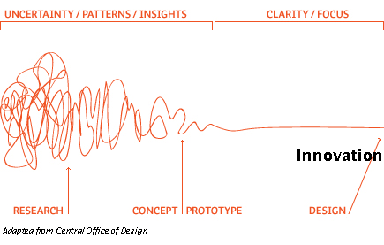
Concept of Design Thinking
Design thinking offers a structured framework for understanding and pursuing innovation in ways that contribute to organic growth and add real value to your customers.
The design thinking cycle involves
Observation to discover unmet needs within the context and constraints of a particular situation,
framing the opportunity and scope of innovation,
generating creative ideas, testing and refining solutions.

Slide 7
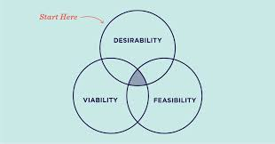
Design Thinking – Essentials
In employing design thinking, following are essential:
Desirability: Putting together what is desirable from a human point of view.
Viability: Economical viability
Feasibility: Technologically feasible.

Slide 8
Differences – Designer and Scientist
S.No. | Scientist | Designer
1. | Scientists are the ones who create the theories | Designer are the ones who implement them
2. | Scientists tell the designer what to make | Designer tell the scientists the constraints that said thing to be made doesn't meet.
3. | Scientists are problem-focused and are interested in the analysis | Designers are solution-focused and are interested in synthesis
4. | For example, scientist tend to find similarities among things that are different | For example, Designers create feasible ‘wholes’ from infeasible ‘parts’
5. | Characteristics include objectivity, rationality, neutrality, and a concern for ’truth’ | Characteristics include practicality, ingenuity, empathy, and a concern for ‘appropriateness’
6. | Science: In the natural world, controlled experiment, classification, analysis | Arts: In the artificial world, involves analogy, metaphor, evaluation

Slide 9
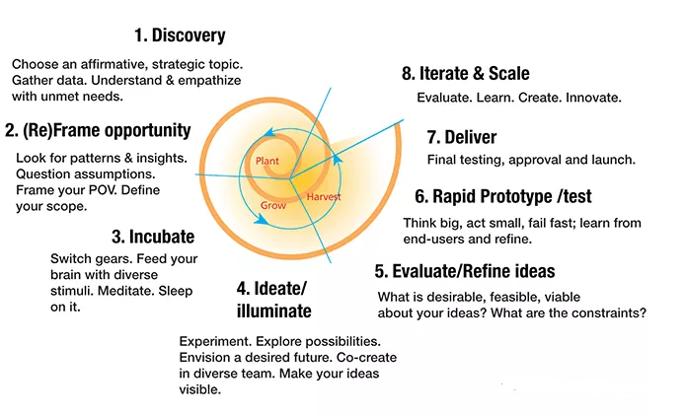
Design Thinking Framework
that benefit the end user.

Slide 10
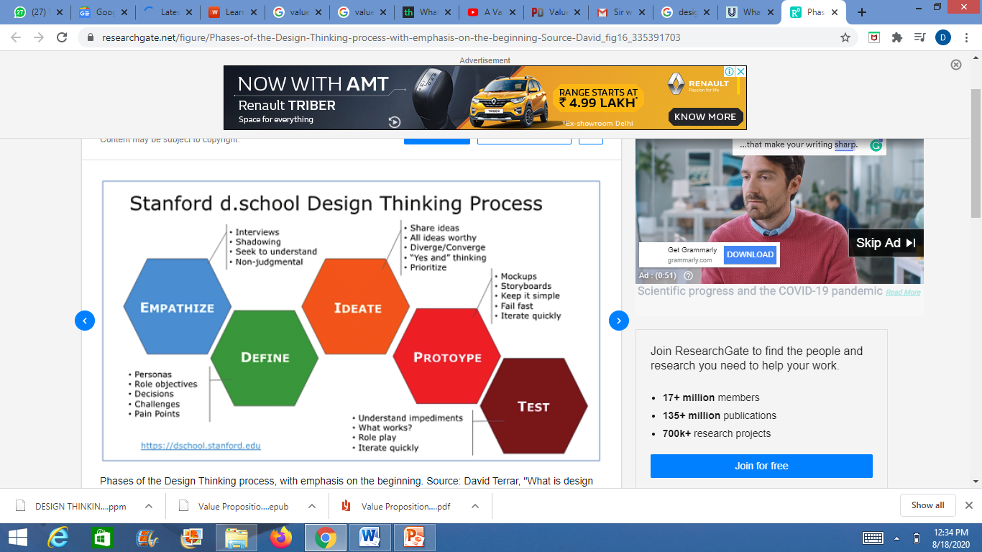
Stages of Design Thinking
Five stages of Design Thinking

Slide 11
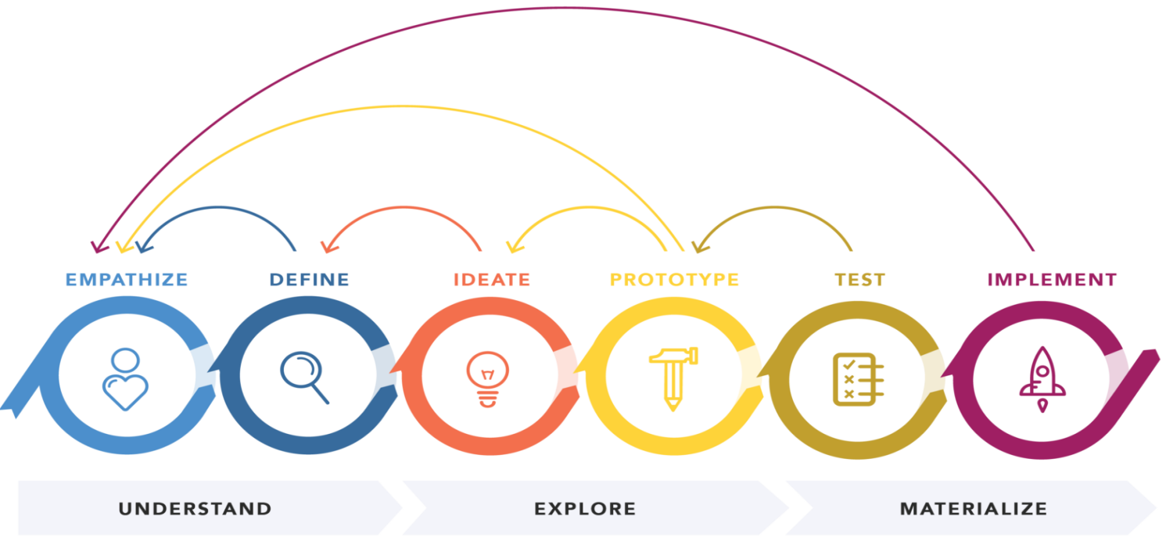
Stages of Design Thinking
Five stages of Design Thinking

Slide 12
Stages of Design Thinking
Five stages of Design Thinking
Empathize (learn about the audience for whom design is undertaken),
Define (construct a point of view that is based on user needs and insights),
Ideate (brainstorm and come up with creative solutions),
Prototype (build a representation of one or more of the ideas generated so as to show to others), and
Test (return to the original user group and test the ideas for feedback).

Slide 13
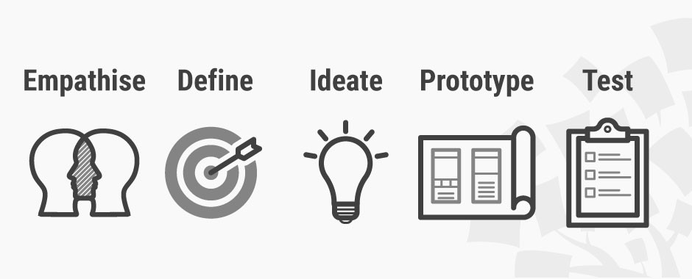
Stages of Design Thinking
Five stages of Design Thinking

Slide 14
Stages of Design Thinking
First Stages – Empathize
This stage is meant to get a better understanding of the problem that needs to be solved.
A substantial amount of information is gathered during the Empathize stage and is carried on to the next few stages to help define the problem and understand how to deal with it.
This includes:
consulting experts of the matter,
engaging farther into the issue to better understand the problem at hand,
as well as working the issue though as a group to have a deeper comprehension of everything that is involved with the problem.

Slide 15
Stages of Design Thinking
Second Stage – Define
During this stage in the Design Thinking process all the information gained during the Empathize stage is put together.
Essentially, data is analyzed and put in order to better concrete on the problems that has been defined.
The Define stage will help gather great ideas and understand how to use them effectively.

Slide 16
Stages of Design Thinking
Third Stage - Ideate
During this stage, Design thinkers start to use the information from the previous stages to generate logical ideas.
From here, ideas are generated that may be “out of the box” or perhaps just ideas that may normally skipped over when not all of information is presented.
This stage allows for an alternative way to solve normalized problems.
It’s important during this phase that a log of ideas be generated so as to choose from when starting the next phase in the Design Thinking process.

Slide 17
Stages of Design Thinking
Fourth Stage - Prototype
During this stage the team will work on creating a number of inexpensive products with specific features.
This allows for the Design Thinkers to investigate possible solutions to the problems that were identified in the earlier stages of the Design Thinking process.
With each new prototype, the team investigates a different aspects of the problem and explores how each of the prototypes would fix the problem.
By the end of this stage, the Design Thinkers should have a better understanding of the constraints the are apparent of the prototype.

Slide 18
Stages of Design Thinking
Fifth Stage - Test
During this stage Design Thinkers test their prototypes made in stage four.
They test their prototypes to see how well they solve/handle the problem that they initially analyzed in stages one and two.
Even during this step, the team can and will make alterations and refinements in order to make the product more polished for their needs.
With this process, the team can go back to previous stages and revise their information to get the best outcomes for their end product.

Slide 19
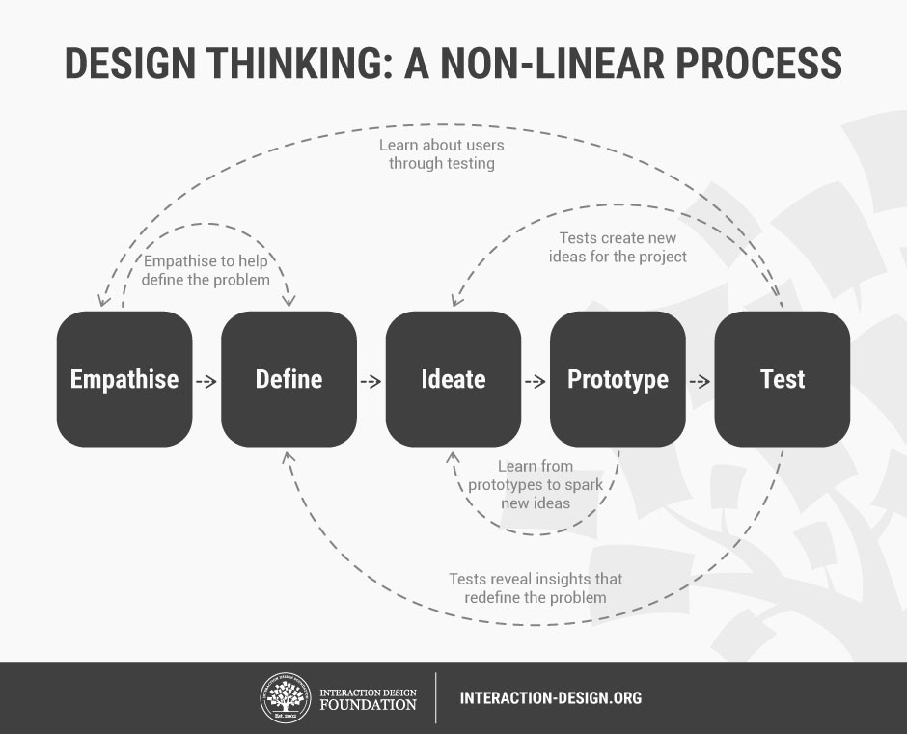
Stages of Design Thinking
Five stages of Design Thinking

Slide 20
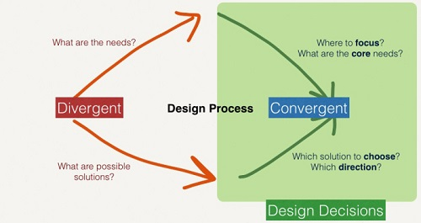
Convergent Vs Divergent Thinking

Slide 21
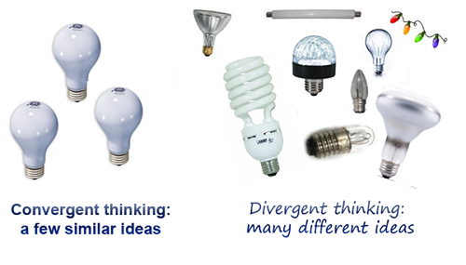
Convergent Vs Divergent Thinking

Slide 22
Convergent Vs Divergent Thinking
Convergent Thinking
Joy Paul Guilford, an American psychologist, coined the term “convergent thinking”.
It refers to figuring out a certain established solution to a problem.
This is often employed in structured assessments such as multiple-choice items, identification, and arithmetic problems.
The characteristics are fast, precise and logical thinking to arrive at the solution is linear based on rational steps.
Example: John Kennedy used convergent thinking to figure out that America could beat Russia into space by sending a man on the moon and NASA team employed divergent thinking in developing the equipment and lunar modules.

Slide 23
Convergent Vs Divergent Thinking
Divergent Thinking
Divergent thinking talks about considering several solutions to a certain problem.
It is sometimes referred to as “lateral thinking” which is a term credited to Edward De Bono, a Maltese psychologist, physician, author, and inventor.
He proposed that problems should be solved through indirect and creative strategies.
This mindset is best utilized in inventive tasks such as free writing, creative artwork, mind mapping, and brainstorming.
The characteristics are Instinctual, Free-flowing and Complex.
Concepts are multilayered and involve numerous standpoints.

Slide 24
Definition of Liberal Art
College or university studies (such as language, philosophy, literature, abstract science) intended to provide chiefly general knowledge and to develop general intellectual capacities (such as reason and judgment) as opposed to professional or vocational skills such as medicine, business and engineering.
Major Categories within liberal arts include:
Humanities - English Literature, Modern Languages, History, and Philosophy
Social Sciences - Anthropology, Economics, Geography, Political Science, and Sociology
Creative Arts - Fine Art, Theatre, Speech, and Creative Writing
Sciences – Astronomy, Biology, Chemistry, and Physics

Slide 25
Importance of Liberal Art
Liberal arts courses teach a broad range of skills.
Employers are more likely to hire someone with a liberal arts background.
Many skills taught in the liberal arts tradition are useful in any career field.
The liberal arts tradition can increase world-view and add depth to college experience.
Culture-based creativity is a key input for businesses or public authorities which want to communicate more effectively, challenge conventions and look for new ways to stand out.
It contributes to product innovation, to branding, to the management of human resources and communication.

Slide 26
Role of Art and Culture in Innovation Business
The Harvard Innovation Lab provides resources for students to collaborate on ventures across schools.
The School of Engineering and Applied Sciences’ mission statement notes, “To address current and future societal challenges, knowledge from fundamental science, art, and the humanities must all be linked through the application of engineering principles with the professions of law, medicine, public policy, design and business practice.”

Slide 27
Role of Art and Culture in Innovation Business
In today’s world, one of the ways innovative products and services can be developed is by examining the intersection of otherwise unrelated fields.
The liberal arts lend themselves to this exact approach, as students are exposed to many different subject areas that they can then mix together.
Example: When the Harvard Graduate School of Education Innovation and Ventures in Education group hosted its second annual hackathon.
The ideas that came out of the event focused on using technology to help solve educational needs. These new and innovative ideas were through the combination of concepts from technology, education, psychology, and other fields.

Slide 28
Role of Art and Culture in Innovation Business
Example: Mark E. Zuckerberg and his creation of Facebook.
During his time at Harvard, Zuckerberg, took classes in both Computer Science and Psychology.
He noticed the concept of a “social network” in his psychology class and combined it with the idea of a “graph” in computer science.
And so was born of one of the great tech companies of our generation.

Slide 29
Role of Art and Culture in Innovation Business
Example:
When Virgin Atlantic entered the airline business the differentiation came from entertainment services and the experience offered on transatlantic flights.
Virgin was the first airline to offer massage on board or multiple choices of music and videos; a service that has now become a standard norm in air travel.
Virgin founder, Sir Richard Branson, came from the music business and applied the “hip” and “cool” values” associated with the Virgin record label to the airline industry.
Virgin Atlantic decided that it would do more than transport people from place to place.

